Slide 1
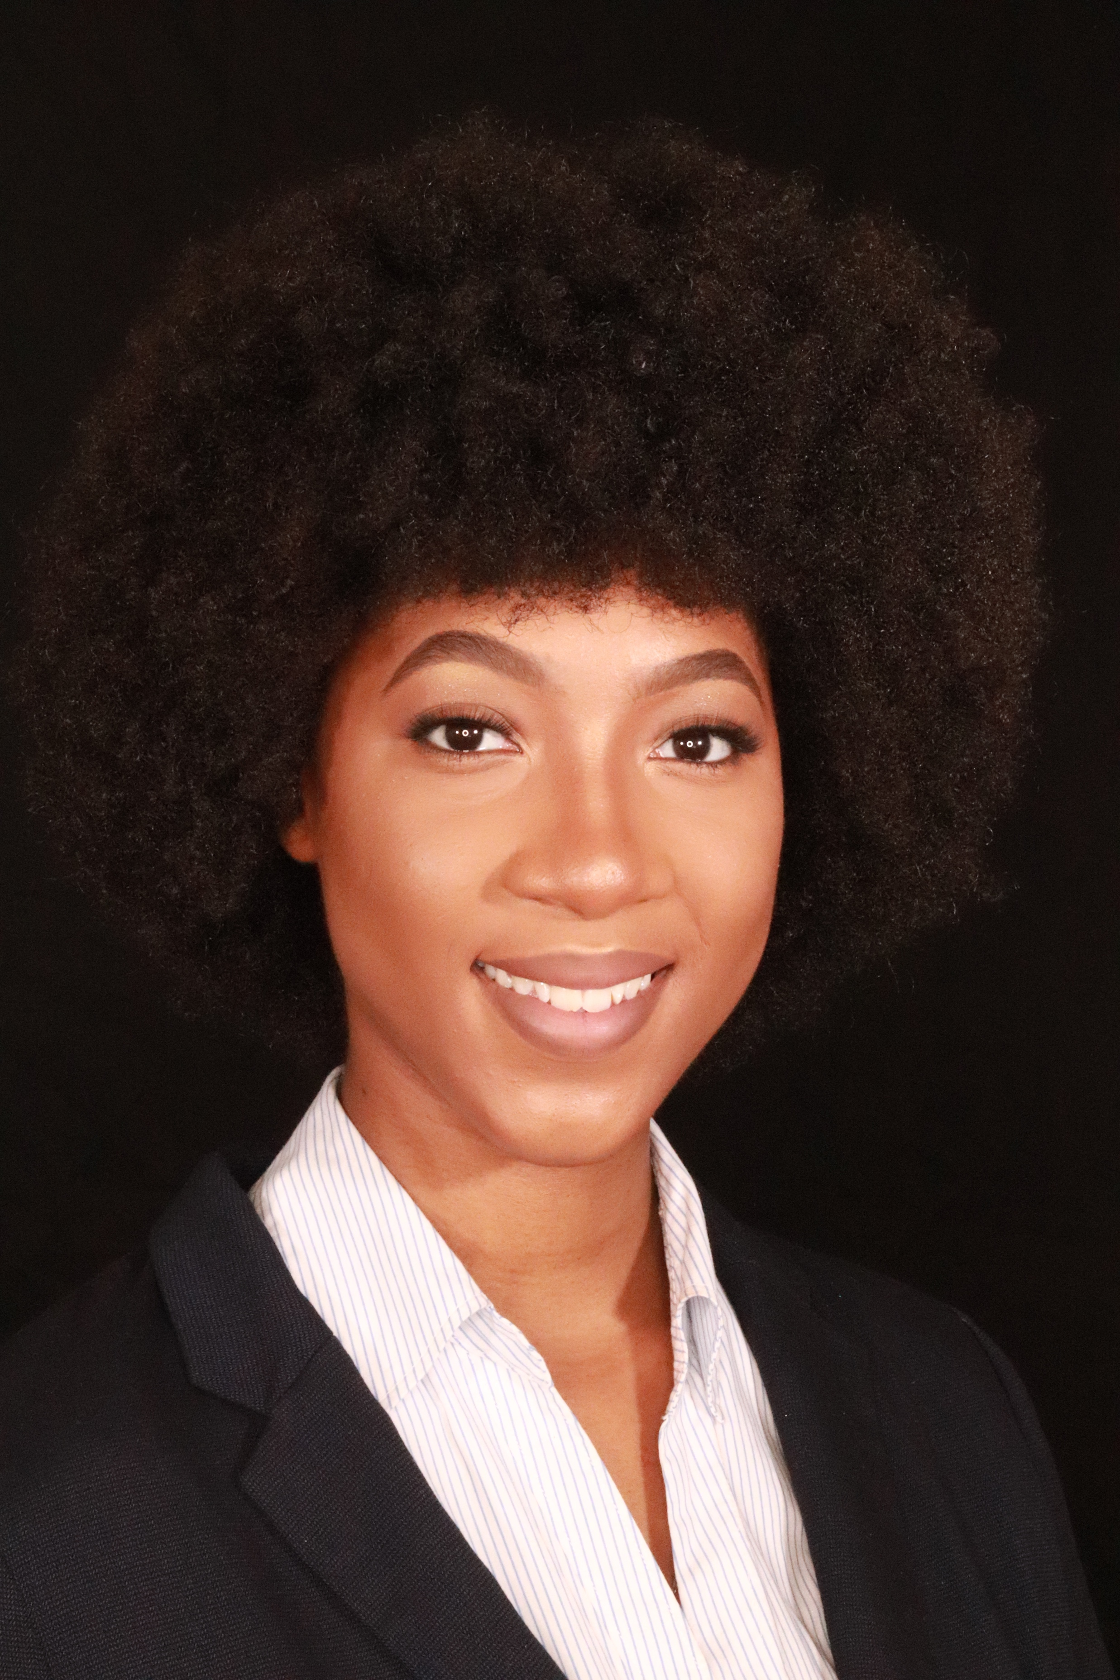
Final Week!
Turn in Week 7 Packet.
1
You can email it, upload to FOCUS, or submit it in Teams.
Work on Week 8 packet
2
Please see assignment tab in TEAMS or FOCUS.
Join Live on Teams
3
I will be live Wednesday 12-2 to answer questions about the final assessment.
Ms. Jackson
Check in!
4
Attendance will be submitted on Tuesdays so please be sure to check in with me.
Jacksonz@leonschools.net
Office hours: M-F 12-2
Submit Week 8 packet
5
Remember Ms. Jackson puts grades in on Mondays, so get that work in!

Slide 2
How to Contact Ms. Jackson:
Remind Codes
MS Teams
Outlook
Period: @kfcbkkd39c
Period 3: @3kdc48bg8e
Period 4: @eedd4kkc33
Period 5: @h4dk7dgb4g
Period 6: @8e7g8gc79g
Students have been added to Microsoft Teams. You can find the app in your Classlink.
I will try to respond to your email within 24 hours.
Jacksonz@leonschools.net
.

Slide 3
All Done!
Do your best on this final assessment especially if you have not been able to complete each weekly packet.
It has been my pleasure working with you all. I’m sad our time was cut short, but I hope to see you at the parade on Thursday @5 pm to celebrate your accomplishments. See the Cobb homepage for more information.
You did it!

